Slide 1
Demo Hörbuch
Cem Güleç
24.02.2025

Slide 2
Outline
Sample of the Audioplay
General Pipeline
Script Explanation
Parser
Text to Speech
Model Selection
Challenges
Future Work

Slide 3

1. Sample of the Audioplay
Elevenlabs:
Amazon Polly:
OpenAI:
Meta Audiocraft:
Notes:
Background music: 49. sn

Slide 4
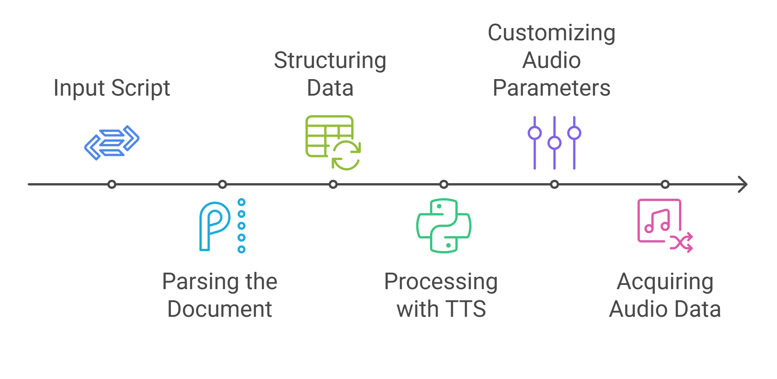
2. General Pipeline

Slide 5
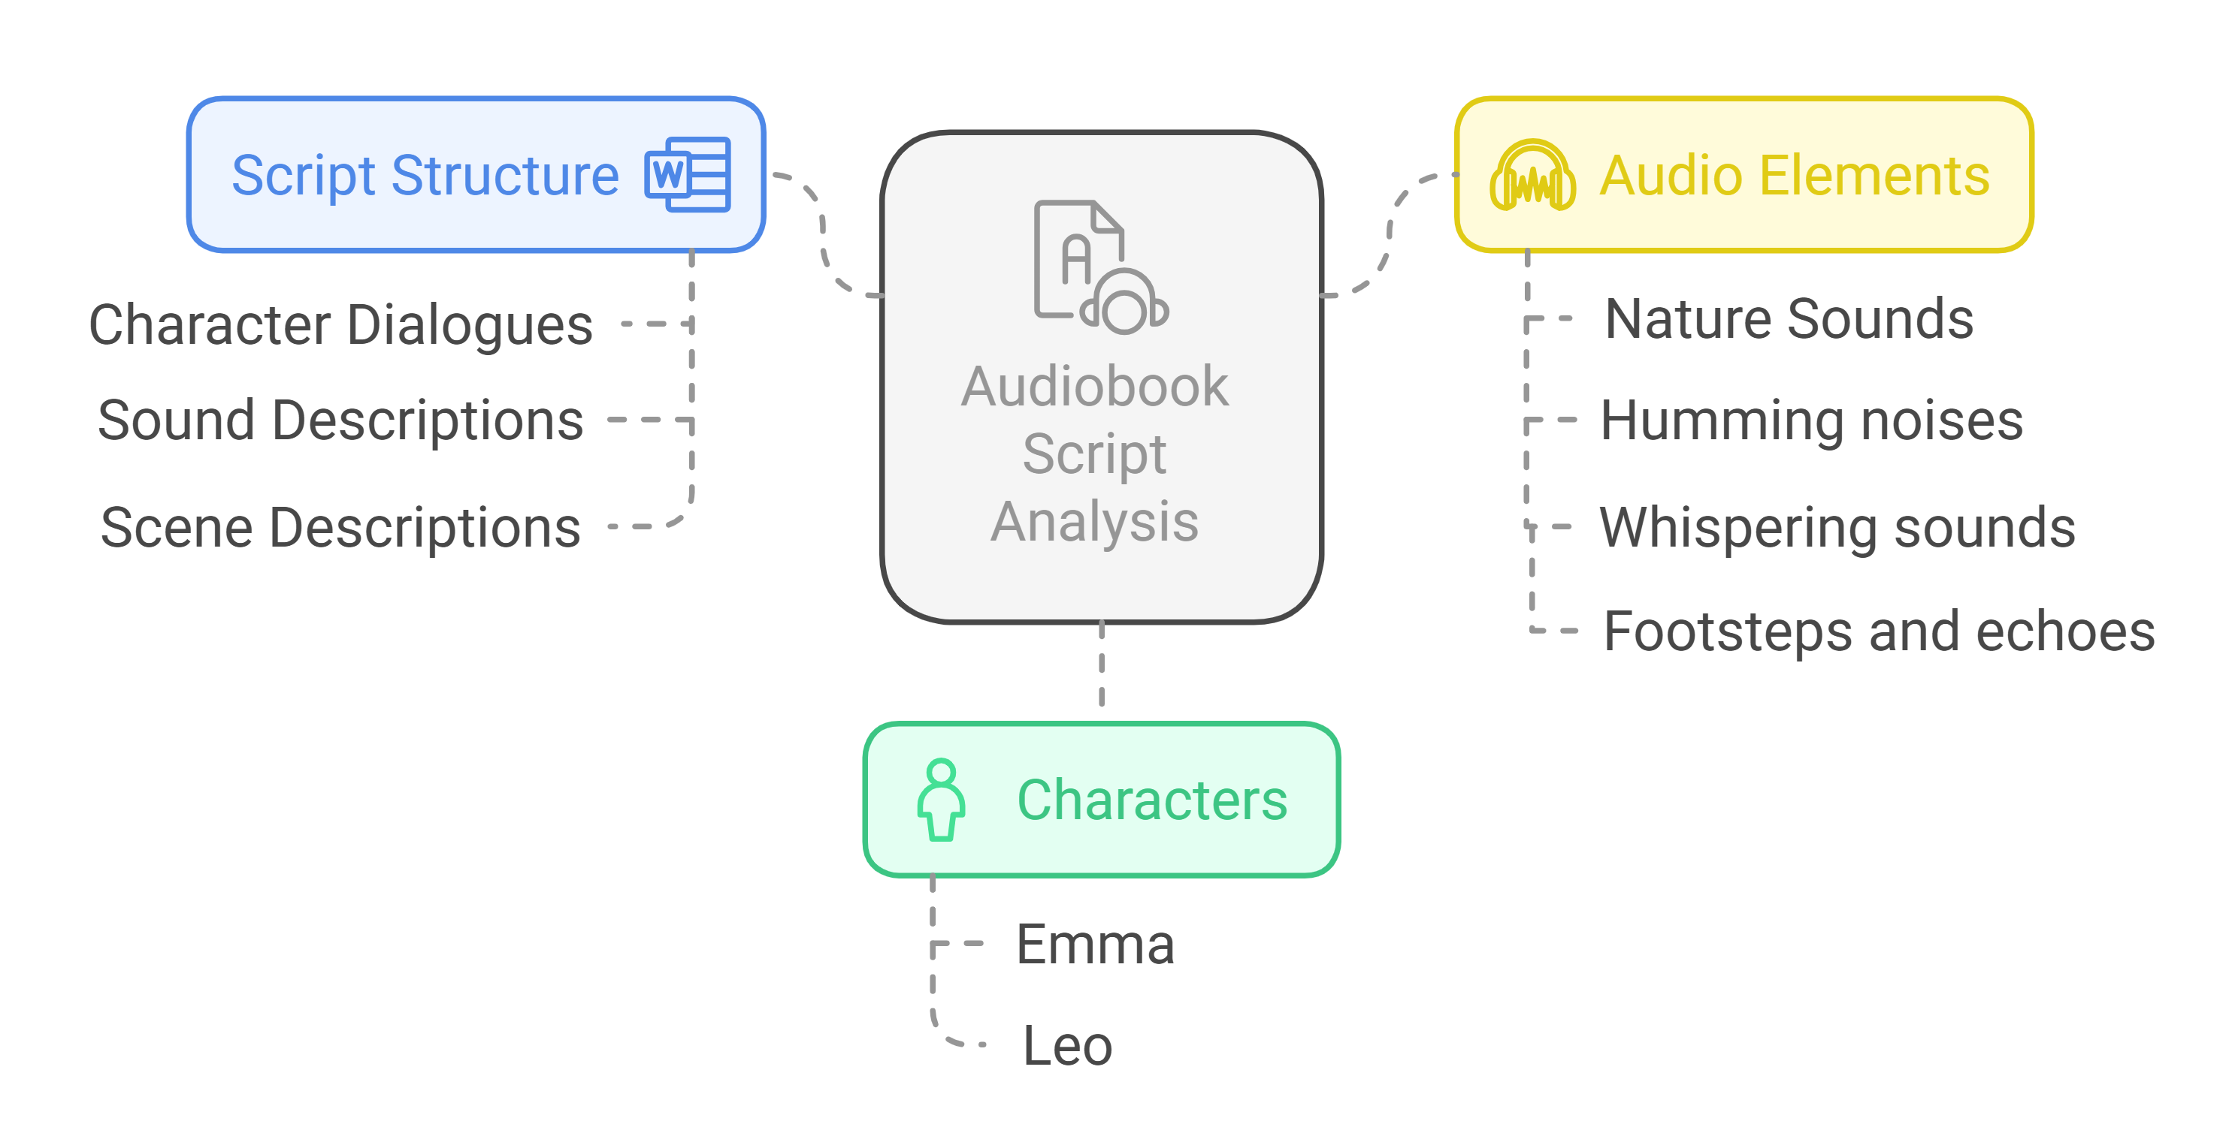
3. Script Explanation

Slide 6
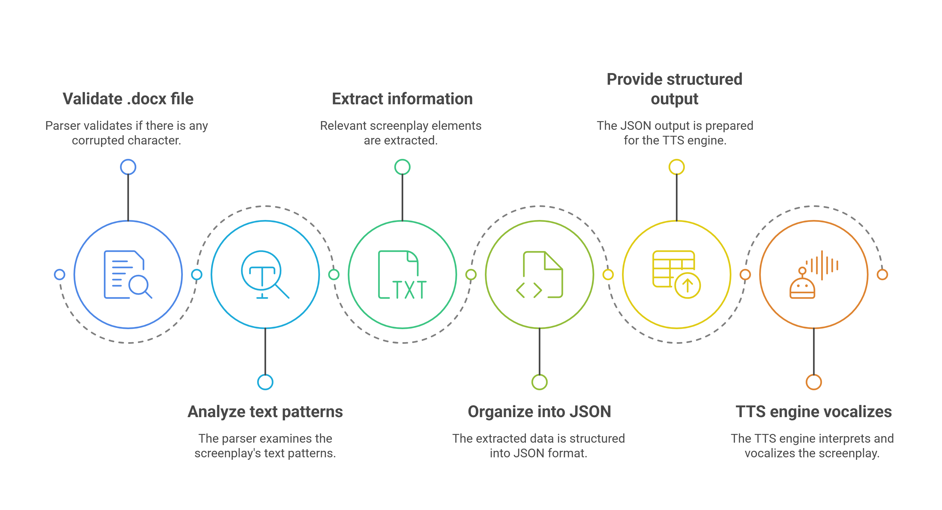
4. Parser
Notes:
- Scalable ve otomatize vurgusu

Slide 7
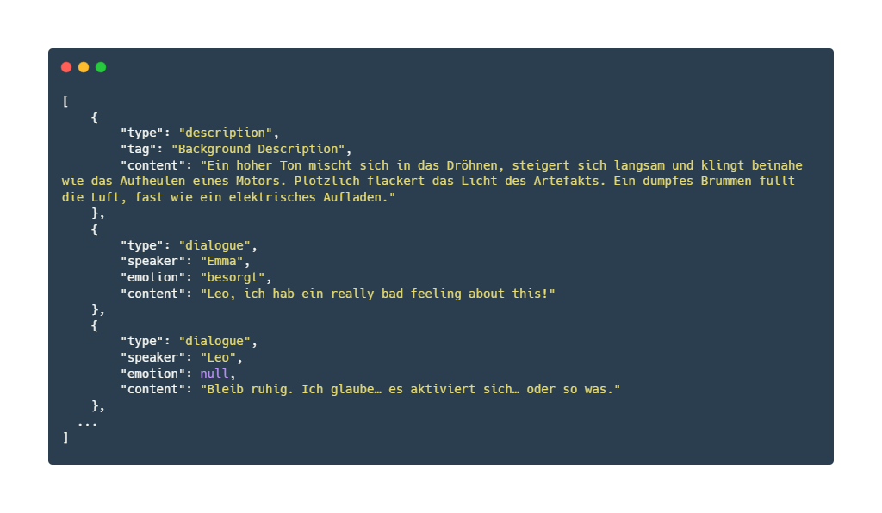
Example JSON Output

Slide 8
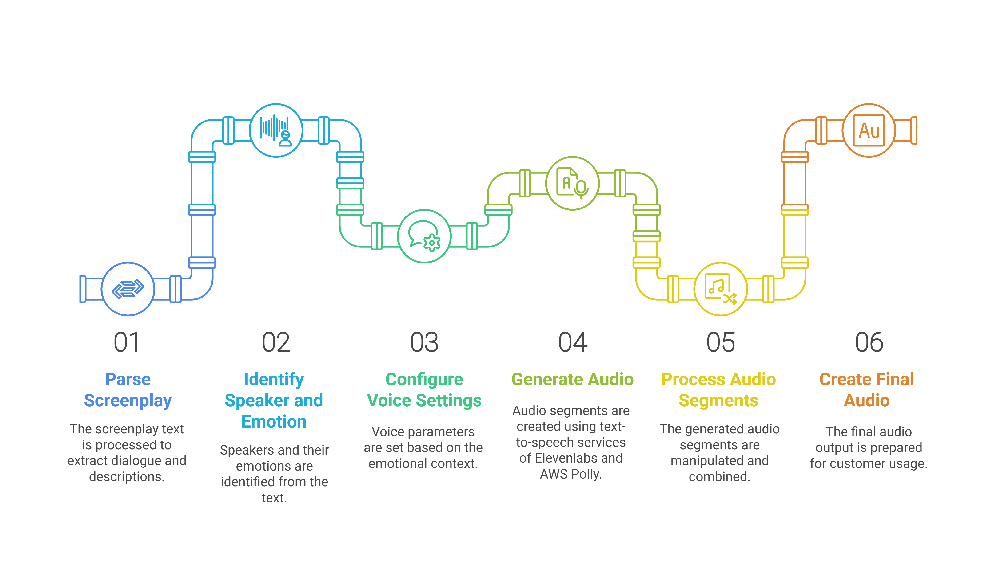
5. Text-to-speech

Slide 9
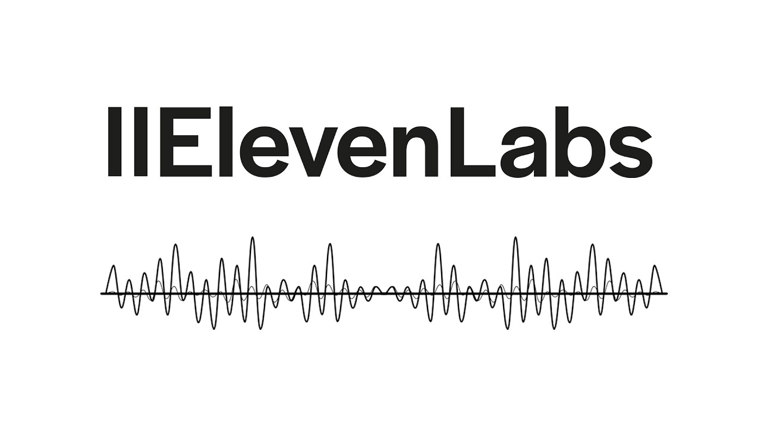
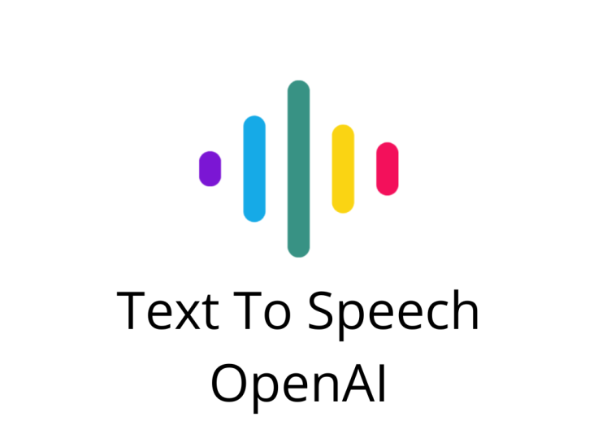


6. Model Selection

Slide 10
7. Challenges
Emotion handling
Tradeoff between quality and generation time
Audio continuity and timing
Sound effects integration
Maintaining character identity across limited voices

Slide 11
8. Future Work
Enhanced emotion control and expression
Parameter tuning
Full stack application
Thumbnail cover picture

Slide 12


Thank you for listening!

Slide 13
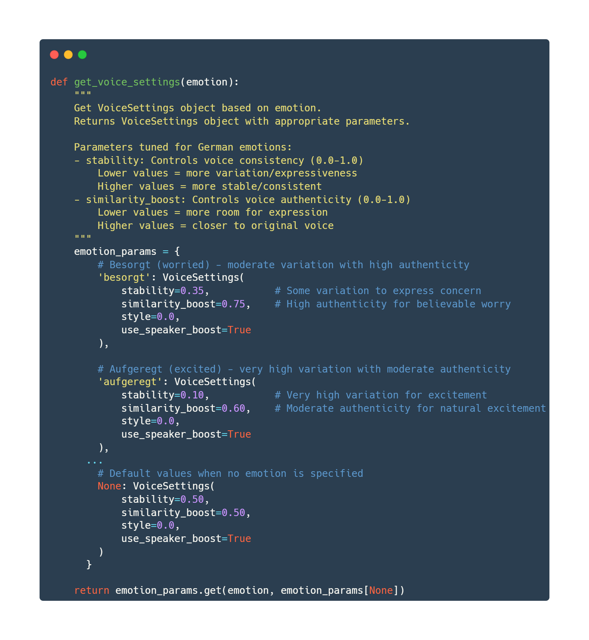
Notes:
Stability (0.0-1.0): Controls voice consistency
Low values (like 0.10 for "aufgeregt"/excited): Creates more variation and expressiveness,
allowing the voice to fluctuate in pitch, rhythm, and intensity - perfect for showing excitement
High values (like 0.35 for "besorgt"/worried): Provides moderate variation while maintaining
some consistency, suitable for concerned emotions that aren't wildly expressive - Default (0.50): Balanced, neutral delivery
Similarity_boost(0.0-1.0): Controls how authentic or close to the original voice the output sounds - High values (like 0.75 for "besorgt"): Keeps the voice recognizable while allowing enough expression to convey worry - Medium values (like 0.60 for "aufgeregt"): Allows more deviation from the original voice to express excitement Style: only was available on premium models
Use_speaker_boost: Enabled for all emotions, enhances speaker characteristics

